Slide 1

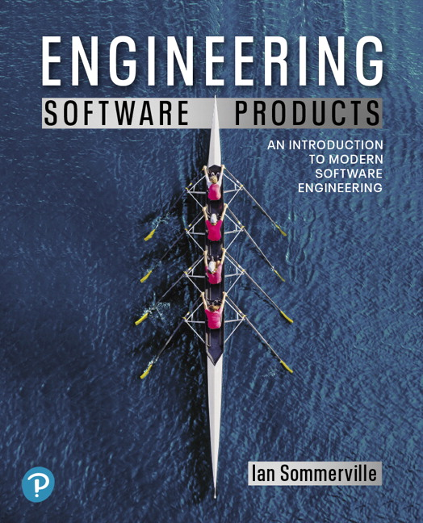
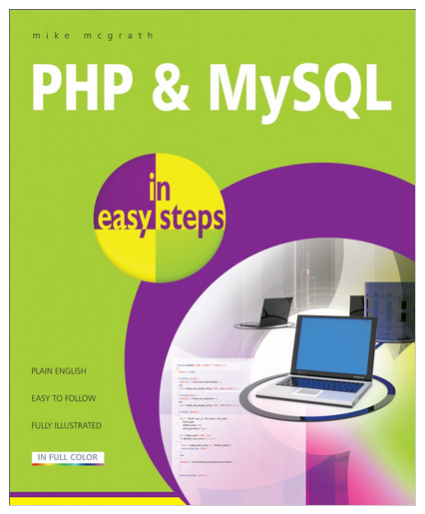
Software Development II Module 06b Cloud Servers, Linux Ubuntu
12/06/2021

Slide 2
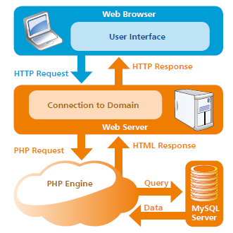
Understanding the WEB
“PHP & MySQL In Easy Steps”

Slide 3
Multi-tier client-server architecture
PHP/MAMP HTML/JS
MYSQL
Sometimes systems will use additional servers or even third-party systems

Slide 4
Cloud Services: Scalability, elasticity and resilience

Slide 5
Scaleability, elasticity and resilience
Scalability – how your software copes with increasing numbers of users.
As the load on your software increases, your software automatically adapts so that the system performance and response time is maintained.
Elasticity - allows for scaling-down as well as scaling-up.
That is, you can monitor the demand on your application and add or remove servers dynamically as the number of users change.
Resilience – how your software tolerates server failures.
You can make several copies of your software concurrently available. If one of these fails, the others continue to provide a service.

Slide 6
Benefits of using the cloud
Cost You avoid the initial capital costs of hardware procurement
Startup time You don’t have to wait for hardware to be delivered before you can start work. With a cloud, servers are quickly up & running!
Server choice If you find that the servers you are renting are not powerful enough, you can upgrade to more powerful systems. You can add servers for short-term requirements, such as load testing.
Distributed development If you have a distributed development team, working from different locations, all team members have the same development environment and can seamlessly share all information.

Slide 7
Virtual cloud servers
A virtual server runs on an underlying physical computer and is made up of an operating system plus a set of software packages that provide the server functionality required.
A virtual server is a stand-alone system that can run on any hardware in the cloud.
This ‘run anywhere’ characteristic is possible because the virtual server has no external dependencies.

Slide 8
Everything as a service

Slide 9
Migrating to AWS
We are going to migrate from our laptops to an AWS server
AWS servers are called "instances"
With our AWS account we can create multiple "instances"
Whatever software we loaded on our laptops, we have to load the same applications on our AWS instance
While our laptops run on Windows or MAC OS, our AWS instance will run on Linux

Slide 10
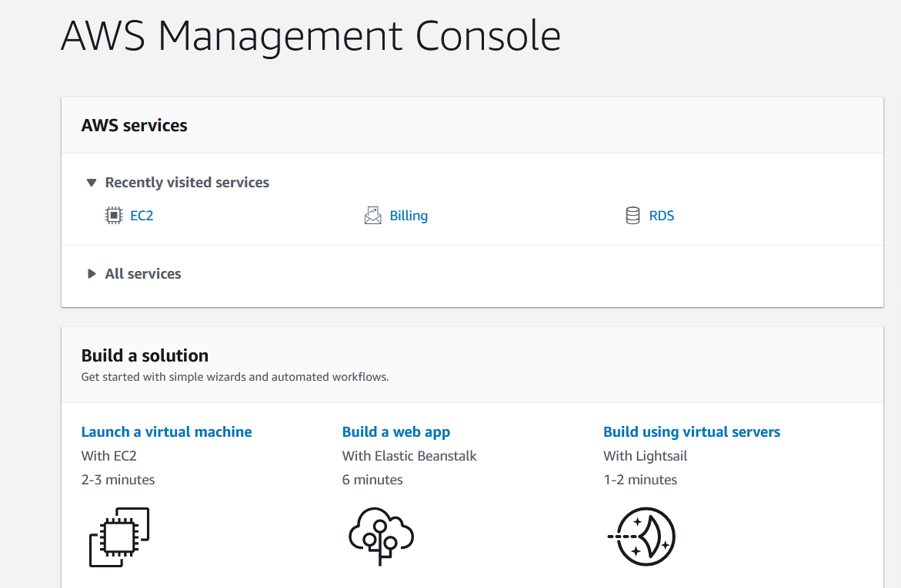

Slide 11
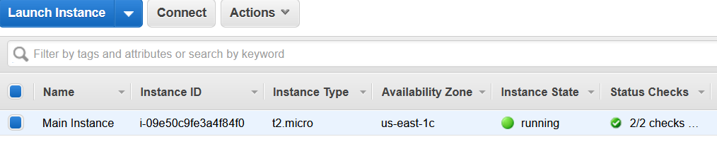
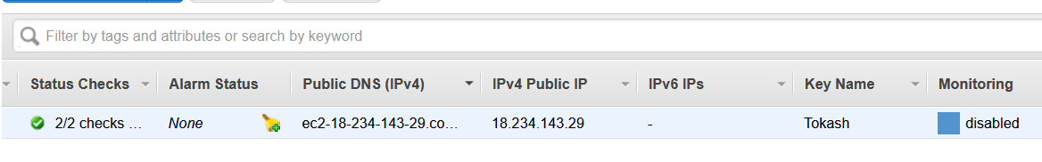
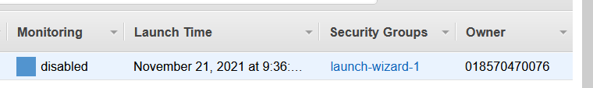

Slide 12
Creating & Configuring our First Instance
To create an instance we need to follow specific instructions carefully. Missing certain details may cause operations to later fail, which will require debugging or recreating the instance! You must read the instructions carefully!!!
This will be an multi-step process
We'll specify the type of server we need. We'll create an "Ubuntu" server, which is a special version/distribution of Linux designed for personal and education use. We'll also use an AWS 'free tier' server.
We'll configure the server. We'll use most of the default options, but we'll also add a security rule to allow HTTP (port 80) connections!

Slide 13
Creating & Configuring our First Instance
We'll create a 'key pair' for security. This will be a file used in follow-on steps. I suggest naming the file the same as the instance name, and ensure you know the file location!
We'll create a PEM file
We'll convert this PEM file to a PPK file for use with Filezilla
We can connect to the server from the AWS (browser) console – this will put us into terminal mode so we can run linux commands to do the following:
Update Linux
Load Apache *
Install & Configure MySql
Install PHP and PHPAdmin
We'll be able to write a simple Hello World PHP file to verify
We'll later use FileZilla to transfer our projects over

Slide 14
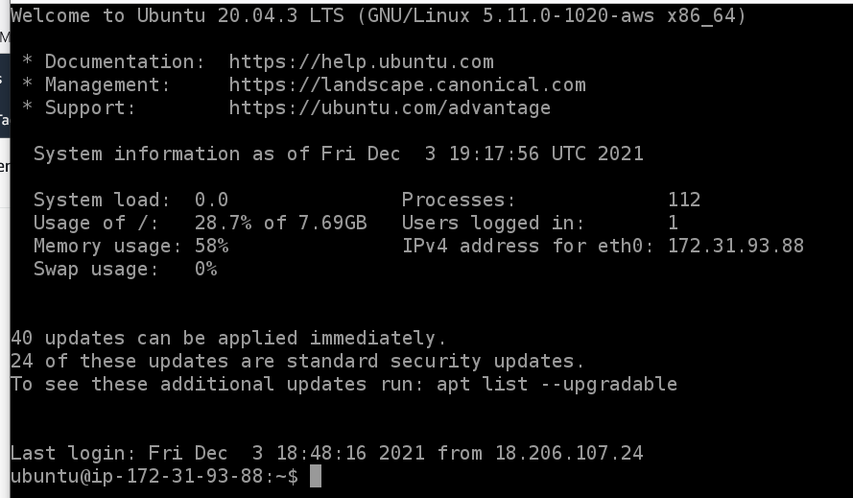
Basic Linux Commands
The default AWS Ubuntu command prompt is a "$"

Slide 15
Basic Linux Commands
Note: Linux filenames are case sensitive!!
We'll be putting our web server code in directory /var/www/html/
But we'll put "connect_db.php" in /var/www/
Command | Function
ls | List files in directory
cd | Change directory
sudo | Super use – allows us to run commands in admin mode
cat > | One way to easily creates a file
sudu apt-get | Gets a package to load software
sudo mysql -u root –p | Starts MySql command mode
sudo chmod sudo chown | Changes file permissions

Slide 16

"Why Hackers Use Linux?"
Linux is open source – you can change an manipulate, make a system operate in a way not intended
Linux is transparent - we can see all working parts
Linux offers granular control – in Windows you can only control what Windows allow you to
Most hacking tools are written for Linux
The future belongs to Linux/Unix

Slide 17
Module 15
Client/server architecture
Virtual servers – what & why
Scalability, elasticity, resilience
Benefits of using the cloud
SaaS, PaaS, IaaS
AWS instances
Basic Linux commands
Create an AWS instance
Configure an AWS instance for our needs
Install our project code on AWS

